Slide 1


MCA MINI PROJECT | FINAL PRESENTATION
PACKTRACE
LIVE
GPS-BASED GROUP RIDE TRACKING SYSTEM
A Web-Based Real-Time Location Sharing Application for Bike Riders
PRESENTED BY
GUIDE
Alan Johny
Ms. Divya S B
ROLL NO
DEPARTMENT
14
Department of Computer Applications
REGISTER NO
COLLEGE
MLM25MCA2015
Mangalam College of Engineering, Ettumanoor
PROGRAMME
S3 MCA
ACADEMIC YEAR
2025–27
Common map | every rider
Notes:
Title slide. Details taken from the brief and the final report cover page (Reg. No. MLM25MCA2015, guide Ms. Divya Gopan, academic year 2025-27).

Slide 2




Why group riders lose each other
INTRODUCTION
Riders get separated
WITHOUT A SHARED VIEW
Speed differences, traffic and fuel stops stretch a group over kilometres.
several km apart
C
B
A
Chat tools share one position each
breakdown / lost signal
No single picture of where the whole group is, and typing while riding is unsafe.
D
wrong turn
PackTrace: one shared map
PackTrace common map
A browser-based dashboard shows every rider, with ride-level safety alerts.
All riders visible on one dashboard, with last-known positions and alerts
Notes:
Source: report Chapter 1 (Background, Motivation). The diagram is illustrative, not data.

Slide 3







Project overview
ABSTRACT
PackTrace is a browser-based application where riders create or join a ride, share live GPS, and see the whole group on one Google Map.
Rider browser
Django backend
Django Channels
Group dashboards
Google Maps
Geolocation API
validates + stores
WebSocket broadcast
every member
rider markers
Safety features
Ride history
Built with
Disconnect detection with last-known location, route deviation alert, SOS broadcast
Completed rides stored with route, travelled distance, duration and members
Python, Django, Django Channels, SQLite, JavaScript, Google Maps JavaScript API
Notes:
Verified in code: consumers.py (RideTrackingConsumer), dashboard.html (watchPosition, Google Maps JS API), services.py (45 s / 500 m thresholds), views.py (ride history, admin monitor).

Slide 4

The problem in one sentence
PROBLEM STATEMENT
During long group rides, continuously monitoring every rider and keeping awareness of the group's location is difficult with conventional messaging and navigation apps.
Riders drift apart
No group-level view
No ride-level safety
Group stretches over kilometres; a breakdown or wrong turn can go unnoticed.
Each shared location is a separate item. No single map of the whole group.
No built-in off-route or dropped-rider detection and no one-action group alert.
Notes:
Problem statement wording follows report Section 1.4.

Slide 5


What PackTrace sets out to do
OBJECTIVES
01
02
03
04
Real-time location sharing
Create and join rides
Common map and route
Disconnected-rider detection
Live GPS of every rider over WebSocket
Ride groups with a unique join code
One Google Map with planned route and rider trails
Mark the rider, keep the last known location
05
06
07
MAIN OBJECTIVE
One shared, real-time view of the whole ride
Route deviation detection
SOS alert
History, login and admin
Flag riders who leave the planned route
One action notifies the ride group
Completed rides, secure authentication, administration
Notes:
Objectives follow report Section 1.3. Status of each objective is in report Table 8.1.

Slide 6




How riding groups coordinate today
EXISTING SYSTEM
WhatsApp / Telegram
Google Maps sharing
Calls and messages
Live location shared into a chat for a limited time
Guides one user; shares position with selected contacts
Manual coordination, distracting while riding
LIMITATIONS FOR A GROUP RIDE
No single map that shows the whole group
No ride concept: group code, leader, planned route
No built-in dropped-rider or off-route detection
No one-action emergency alert to the group
No ride-specific history
Notes:
Source: report Section 2.1. Limitations are described for group-ride use, not as general criticism of these apps.

Slide 7







PackTrace: one ride, one map
PROPOSED SYSTEM
Rider
GPS
Browser
Django + WebSocket
Group dashboard
Map
MAIN ADVANTAGES
Centralised monitoring
Real-time updates
Group ride management
Safety alerts
Ride history
Whole group on one map
WebSocket push, no page reload
Join code, leader, members
Disconnect, off-route, SOS
Review completed rides
Notes:
Flow matches report Section 2.2 and verified code path: dashboard.html watchPosition -> WebSocket (/ws/rides/<id>/) -> consumers.py -> group broadcast -> dashboard marker update.

Slide 8

Scope of the project
SCOPE
CURRENT SCOPE
FUTURE SCOPE
Target users: groups of riders (motorcycle, bicycle, car) using a laptop or smartphone browser
Native Android / iOS app
Offline tracking, SMS fallback
Geofencing, low-battery, no-movement alerts
Push, SMS, email, audio emergency
Automatic accident detection
Ride analytics, cloud scaling
Rider registration and login
Ride creation
Join ride with code
Live location sharing
Map visualisation
Route monitoring
SOS alert
Disconnect handling
Ride history
Administration
Notes:
Current scope items were each verified in the source: registration/login (views.py), create/join (views.py), live location (consumers.py), SOS (consumers.py), disconnect (services.py), ride history (views.ride_history_view), admin (Django admin + /admin-monitor/). Future scope from report Section 9.3.

Slide 9
Recent studies on GPS tracking and safety
LITERATURE REVIEW (1 OF 2)
Author & Year | Topic | Method / Technology | Key finding | Relevance to PackTrace
Aldhahri et al., 2025 [1] | GNN-RMNet: GPS analytics for driver behaviour and route optimisation | Graph neural network with ResNet / MobileNet on GPS trajectories and sensor data | Detects abnormal routes from GPS with high accuracy and low latency | Supports detecting deviation from a planned route using GPS
M.A Al Rashed,O A Oumar,D.Singh(,2013 [2] | Real-time GPS tracking for IoT-enabled connected vehicles | Microcontroller, GSM and GPS modules; server and web interface | Acquire, transmit, store and display positions in a web page | Same pipeline, but PackTrace uses the rider's phone browser, no extra hardware
Boronat et al., 2021 [3] | Cyclist safety through a mobile sensing application | Android app reports position; server returns alarms | Periodic position reporting from a phone suits road-safety use | Supports phone as tracker and a server that sends alerts
Pimentel & Nickerson, 2012 [4] | Communicating and displaying real-time data with WebSocket | WebSocket compared with HTTP polling | Persistent connection lowers overhead for frequent updates | Reason for WebSocket (Django Channels) for live positions
White et al., 2011 [6] | WreckWatch: automatic accident detection with smartphones | Phone sensors detect crashes; web services notify contacts | A phone can notify emergency contacts; false alarms must be managed | PackTrace uses a manual SOS; automatic detection is future scope
Notes:
All papers are from the final report (references [1]-[10]). Most recent first. Aldhahri 2025 [1], Moumen 2023 [2], Boronat 2021 [3], Pimentel & Nickerson 2012 [4], White 2011 [6].

Slide 10
Accuracy, privacy and distance foundations
LITERATURE REVIEW (2 OF 2)
Author & Year | Topic | Method / Technology | Key finding | Relevance to PackTrace
Zandbergen & Barbeau, 2011 [5]; Zandbergen, 2009 [7] | Accuracy of phone-based GPS positioning | Empirical comparison of assisted GPS, Wi-Fi and cellular positioning | Assisted GPS is best; errors grow indoors and among tall buildings | Explains approximate positions and the GPS-accuracy limitation
Consolvo et al., 2005 [8] | Location disclosure to social relations | Field study and interviews | People want control over who sees their location, and when | Basis for consent-based sharing within the ride group
Beresford & Stajano, 2003 [9] | Location privacy in pervasive computing | Risk analysis and mix-zone concept | Stored location records are sensitive and should be limited | Motivates limiting who sees and stores location data
Sinnott, 1984 [10] | Virtues of the Haversine | Great-circle distance formula | Simple and stable for short distances; assumes a spherical Earth | Used for deviation, speed and travelled-distance calculations
Takeaway: the reviewed work covers GPS tracking, smartphone safety alerts, WebSocket delivery, accuracy, privacy and distance, but not a browser-based tool built around a riding group.
Notes:
Remaining papers from the final report: Zandbergen & Barbeau 2011 [5] with Zandbergen 2009 [7], Consolvo et al. 2005 [8], Beresford & Stajano 2003 [9], Sinnott 1984 [10].

Slide 11
Where PackTrace fits
RESEARCH GAP
EXISTING RESEARCH
PACKTRACE
Individual tracking
Group ride
Common map
Vehicle / fleet tracking with dedicated hardware
Live tracking
Disconnect handling
GAP
Native-app safety alerts for hazards
Route deviation
SOS alert
Privacy and GPS-accuracy studies
Ride history
No reviewed work combines these in a lightweight, browser-based tool built around a riding group.
Notes:
Gap statement from report Section 3.10: none of the reviewed works offers a lightweight, browser-based environment built around a riding group.

Slide 12




Technologies actually used
TECHNOLOGY STACK
Frontend
Backend
Maps and routing
HTML, CSS, JavaScript
Browser Geolocation API
WebSocket API
Python 3.14.0
Django 6.1.1
Django Channels 4.3.2
Daphne 4.2.3 (ASGI)
Google Maps JavaScript API
OSRM routing service
OpenStreetMap Nominatim
Database
Development tools
SQLite3 (db.sqlite3)
Django ORM
In-memory channel layer
VS Code
StarUML, Draw.io
GitHub
Notes:
Verified against the ZIP: no requirements.txt is included. Versions were read from the project virtual environment (Python 3.14.0, Django 6.1.1, channels 4.3.2, daphne 4.2.3). Report Table 2.4 lists Python 3.10.11 / Django 5.2.16; settings.py header says it was generated by Django 5.2.16. OSRM and Nominatim are called by the code (routing_service.py, dashboard.html). No Bootstrap is used.

Slide 13


Hardware and software requirements
REQUIREMENTS
HARDWARE
SOFTWARE
Python
3.14.0
Laptop / PC
Dual-core processor, 4 GB RAM, 5 GB free disk, 1366 × 768 display
Django
6.1.1
Django Channels
4.3.2
Smartphone with GPS
Daphne (ASGI server)
4.2.3
Modern web browser, location services enabled
Database
SQLite3
Browser
Current Chrome, Edge or Firefox
Internet connection
Map service
Google Maps API key
Mobile data or Wi-Fi for continuous location exchange
Tools
VS Code, StarUML, Draw.io, GitHub
Notes:
Hardware from report Table 2.3. Software versions verified from the project virtual environment (see slide 12 notes).

Slide 14

Layered architecture
SYSTEM ARCHITECTURE
Laptop or smartphone with GPS
EXTERNAL SERVICES
RIDER / CLIENT
BROWSER (CLIENT LAYER)
Google Maps Platform
HTML
CSS
JavaScript
Geolocation API
WebSocket API
Maps JavaScript API: map, markers, polylines
DJANGO BACKEND (APPLICATION LAYER)
OSRM routing service
Authentication
Ride management
GPS processing
Channels (WebSocket)
Road route, distance and duration
Route deviation
Disconnect handling
SOS alerts
Admin
OSM Nominatim
DATABASE (SQLITE VIA DJANGO ORM)
Destination name lookup (from browser)
RiderProfile
RideGroup
RideMember
LocationLog
SOSAlert
Notes:
Verified: browser layer (dashboard.html, Geolocation, WebSocket, Google Maps JS API), Django backend (views.py, consumers.py, services.py, routing_service.py), SQLite via Django ORM (5 PackTrace models + Django auth). OSRM is called from the backend; Nominatim reverse-geocoding is called from the browser. Channel layer is InMemoryChannelLayer (single-process, development).

Slide 15

From login to ride history
METHODOLOGY/SYSTEM WORKFLOW
1
2
3
4
5
6
Register / Login
Create or Join Ride
Start Ride (leader)
Browser obtains GPS
Location sent to server
Channels distributes update
11
10
9
8
7
Ride History
End Ride
Safety monitoring
Google Maps shows riders
Group dashboard updates
DISCONNECT PATH
Connection closed, or no update for 45 s
Rider marked DISCONNECTED
Last known location retained, marker dimmed
Rider reconnects or sends GPS
Status back to ACTIVE, sharing resumes
Notes:
Workflow follows report Figure 4.6 and was checked against the code: start/end ride are leader actions (views.start_ride_view / end_ride_view); disconnect rules are in services.py and consumers.py.

Slide 16
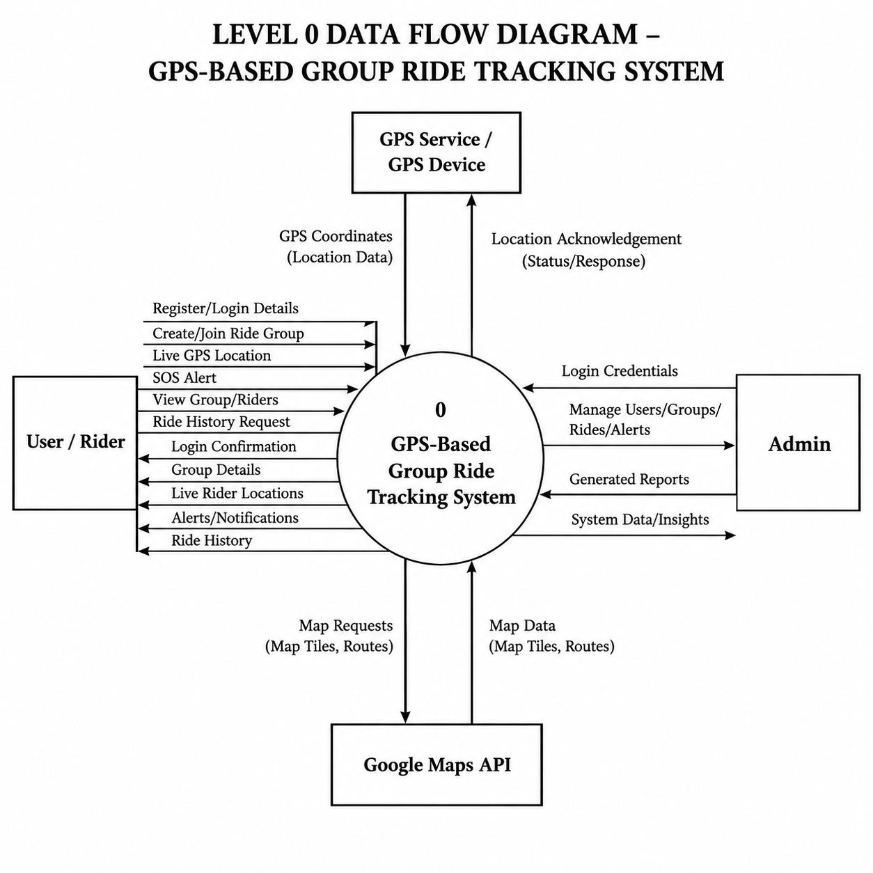
Notes:
Redrawn from report Figure 4.1 (entities: Rider, Admin, GPS source, map service). The map service is Google Maps Platform for display; road routes come from OSRM (routing_service.py).

Slide 17
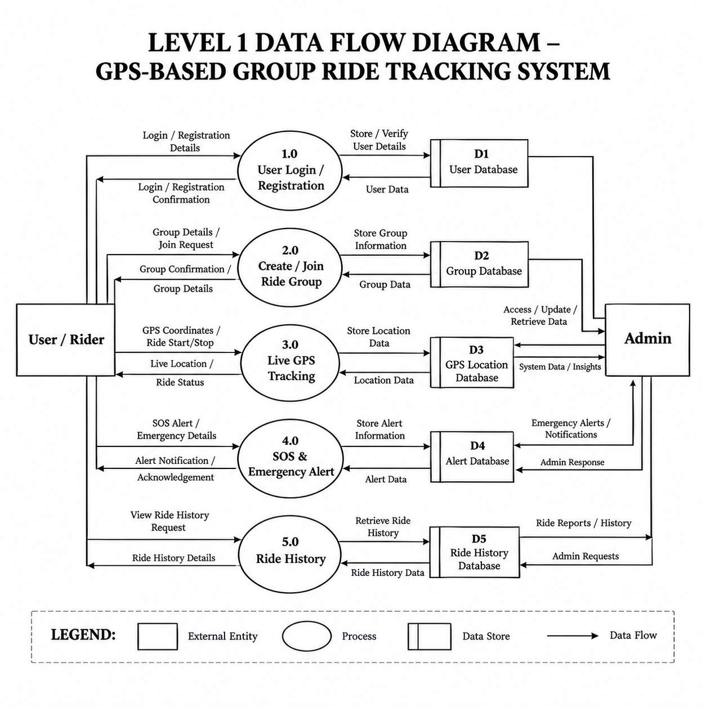
Notes:
Process grouping follows report Figure 4.2, extended with Location Distribution and Route Monitoring as separate processes as requested. Data stores correspond to the real tables: D1 auth user + RiderProfile, D2 RideGroup + RideMember, D3 LocationLog, D4 SOSAlert. Ride history reads D2 and D3 (there is no separate history table).

Slide 18
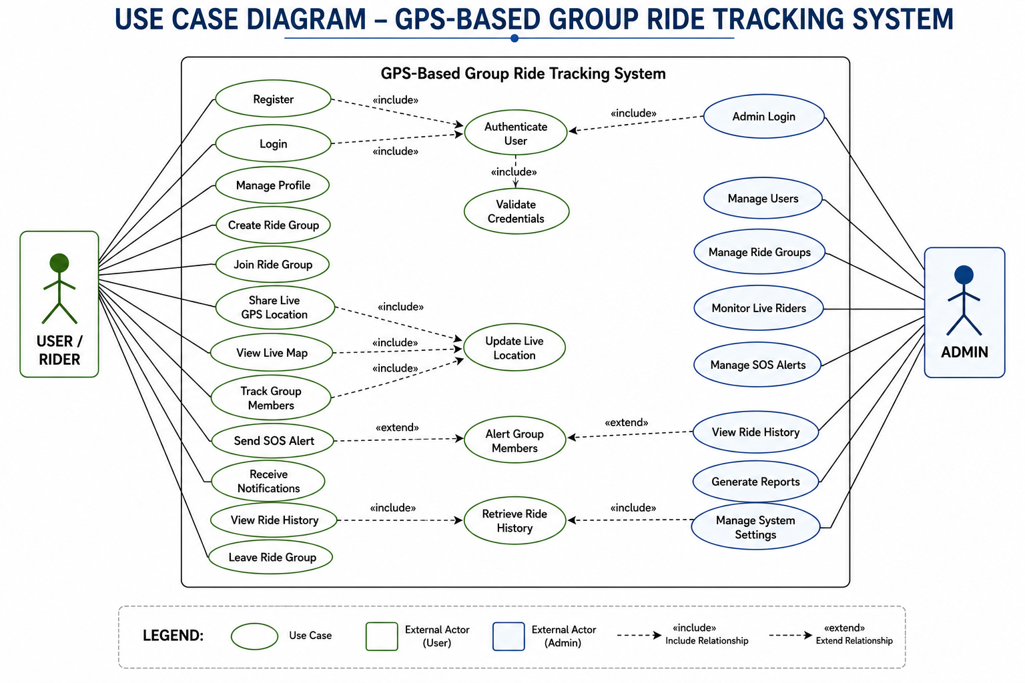
Use case diagram
UML
Notes:
Actors and use cases from report Figure 4.3, limited to what exists in the code. The leader is a rider role (RideMember.role = LEADER) who starts and ends the ride. Administration is the Django admin site plus the custom /admin-monitor/ page.

Slide 19
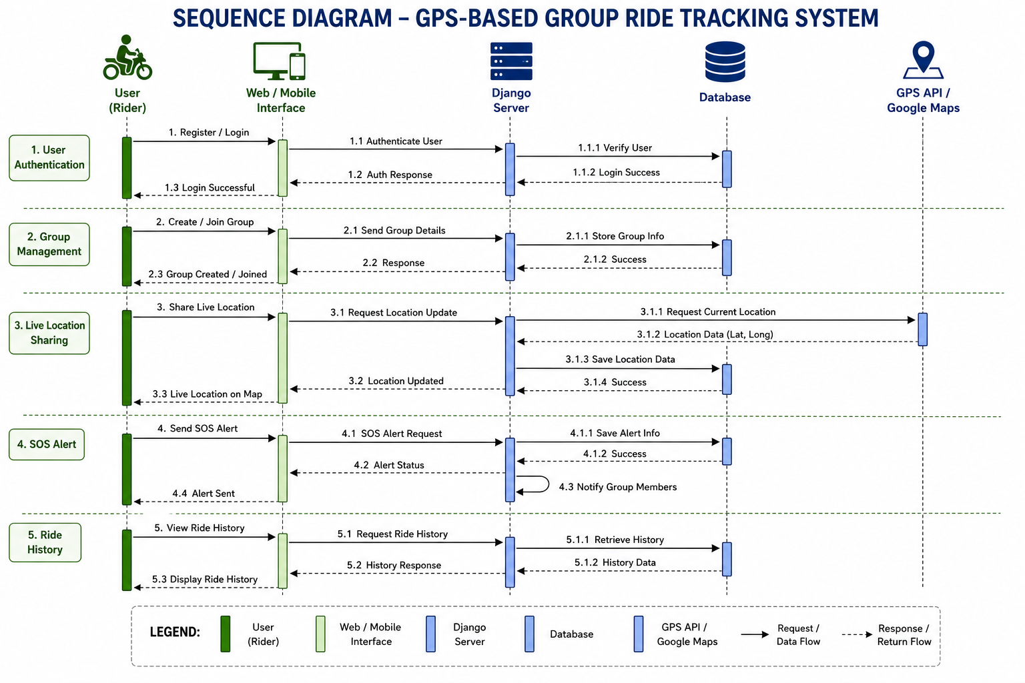
Sequence diagram
UML
Notes:
Actors and use cases from report Figure 4.3, limited to what exists in the code. The leader is a rider role (RideMember.role = LEADER) who starts and ends the ride. Administration is the Django admin site plus the custom /admin-monitor/ page.

Slide 20
ER diagram from the actual models
DATABASE
RIDER_PROFILE
USER (Django auth)
RIDE_GROUP
PK id
FK user (one-to-one)
role, phone, ride_type
location_consent
is_online, last_active
color_code, avatar_initials
PK id
username, email
first_name
password (hashed)
is_staff, is_superuser
PK id
name, join_code (unique)
FK created_by
status, description
destination_name, lat, lng
planned_route (JSON)
route_distance_m, duration_s
started_at, ended_at
1:1
1:N
1:N
1:N
LOCATION_LOG
RIDE_MEMBER
SOS_ALERT
PK id
FK ride_member
latitude, longitude
speed, accuracy, heading
timestamp
PK id
FK group, FK user (unique pair)
role (LEADER / RIDER)
status, is_connected
last_seen, route_deviation
joined_at, left_at
PK id
FK ride_member
latitude, longitude, message
status (ACTIVE / ACK / RESOLVED)
timestamp
FK resolved_by, resolved_at
1:N
1:N
No separate history or notification table exists: ride history is built from completed RideGroup, RideMember and LocationLog rows.
Notes:
Redrawn from tracker/models.py and migrations 0001-0006. PackTrace defines 5 models (RiderProfile, RideGroup, RideMember, LocationLog, SOSAlert) plus Django auth User. The report ER diagram also shows RIDE_HISTORY and NOTIFICATION tables; these do NOT exist in the code. Ride history is computed from completed RideGroup/RideMember/LocationLog rows. Field lists are trimmed for readability; names are as in models.py.

Slide 21


Core modules
MODULES
Authentication
Ride management
GPS tracking
Live map
WebSocket
Email + password, sessions, CSRF
Create, join code, start, end
watchPosition to LocationLog
Markers, route, breadcrumb trail
Channels consumer, group broadcast
Implemented
Implemented
Implemented
Implemented
Implemented
Disconnect detection
Route deviation
SOS
Ride history
Administration
45 s timeout, last known location
Haversine, 500 m threshold
Broadcast; admin acknowledge, resolve
Distance, duration, members
Django Admin + monitor page
Implemented
Implemented
Implemented
Implemented
Implemented
Notes:
Every module below was found in the source. Authentication: views.register_view/login_view, backends.EmailAuthBackend. Ride management: create/join/start/end views. GPS: dashboard.html watchPosition + consumers.handle_location_update. Live map: dashboard.html (Google Maps). Disconnect: services.check_and_update_disconnected_riders. Deviation: services.check_route_deviation. SOS: consumers.handle_sos_alert + admin acknowledge/resolve. History: views.ride_history_view. Admin: admin.py + admin_monitor_view.

Slide 22

Algorithms and logic used
METHODOLOGY
GPS tracking
Distance: Haversine
Browser
GPS
JavaScript
WebSocket
Django
Group
a = sin²(Δφ/2) + cos φ1 · cos φ2 · sin²(Δλ/2)
c = 2 · atan2(√a, √(1−a))
d = R · c, R = 6,371,000 m
watchPosition: high accuracy, 60 s timeout, 5 s max cache
Sends lat, lng, speed, accuracy, heading
Server validates ranges, saves LocationLog, broadcasts
Used for deviation, speed estimate and travelled distance
Planned route distance comes from OSRM, not Haversine
Route deviation
Disconnect detection
Rider GPS vs. each point of the planned route
Nearest-point distance > 500 m: flagged off-route and alert broadcast
Back within 500 m: flag cleared
Checked on every location update
Tracks last_seen for each active rider
No update for 45 s: status DISCONNECTED, last coordinates broadcast
WebSocket close also marks the rider offline
New GPS update: back to ACTIVE
Notes:
Verified values: watchPosition options (dashboard.html: enableHighAccuracy true, timeout 60000, maximumAge 5000); Haversine R = 6371000 m (services.py); DEVIATION_THRESHOLD 500 m from ROUTE_DEVIATION_THRESHOLD_METERS; DISCONNECT_THRESHOLD 45 s from DISCONNECT_THRESHOLD_SECONDS; dashboard polls live-state every 3 s, and that endpoint runs the disconnect sweep; check_disconnects management command also exists. Deviation compares the rider with route points (vertices), not line segments.

Slide 23
Implementation overview
IMPLEMENTATION
PROJECT STRUCTURE
tracker/routing.py
packtrace/ settings, urls, asgi
tracker/
models.py 5 models
views.py HTTP + JSON APIs
consumers.py WebSocket consumer
routing.py ws:// routes
services.py Haversine, alerts
routing_service.py OSRM client
admin.py, tests.py
templates/ login, register,
dashboard, history,
admin_monitor
static/css/ packtrace.css
re_path(r'^ws/rides/(?P<group_id>\d+)/$',
consumers.RideTrackingConsumer.as_asgi())
tracker/services.py
DISCONNECT_THRESHOLD = getattr(settings,
'DISCONNECT_THRESHOLD_SECONDS', 45)
DEVIATION_THRESHOLD = getattr(settings,
'ROUTE_DEVIATION_THRESHOLD_METERS', 500)
templates/dashboard.html
navigator.geolocation.watchPosition(
..., { enableHighAccuracy: true,
timeout: 60000, maximumAge: 5000 })
Google Maps JS API in dashboard.html
OSRM route via routing_service.py
Notes:
File layout and excerpts are copied from the ZIP. tracker/tests.py contains 23 automated test methods (routes, destination, history, registration, OSRM client, disconnect detection); they were not executed while preparing this deck.

Slide 24
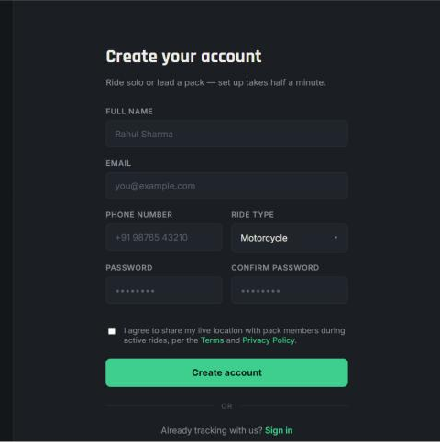
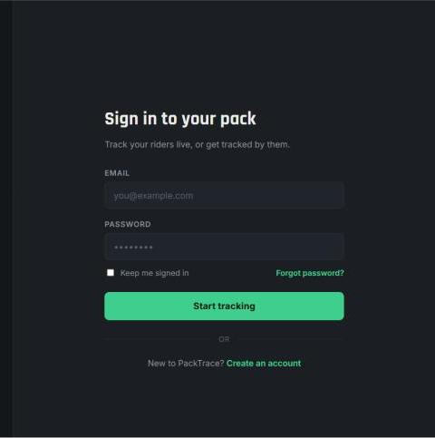
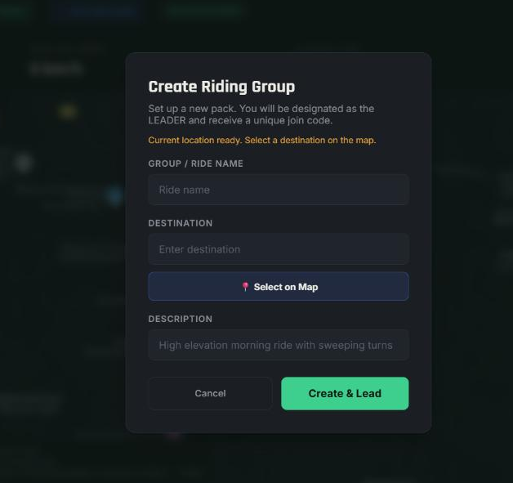
Authentication and ride management
APPLICATION SCREENSHOTS
Registration
Login
Create ride
Name, email, phone, ride type, location consent
Email and password, keep me signed in
Name, destination on map, creator becomes leader
Join with Code: dashboard header controls
Notes:
All images are real screenshots from the final report (Figures 5.2, 5.3, 5.4 and the dashboard header from Figure 5.6). The Join with Code control is shown as a header crop because the report has no separate join-dialog screenshot.

Slide 25
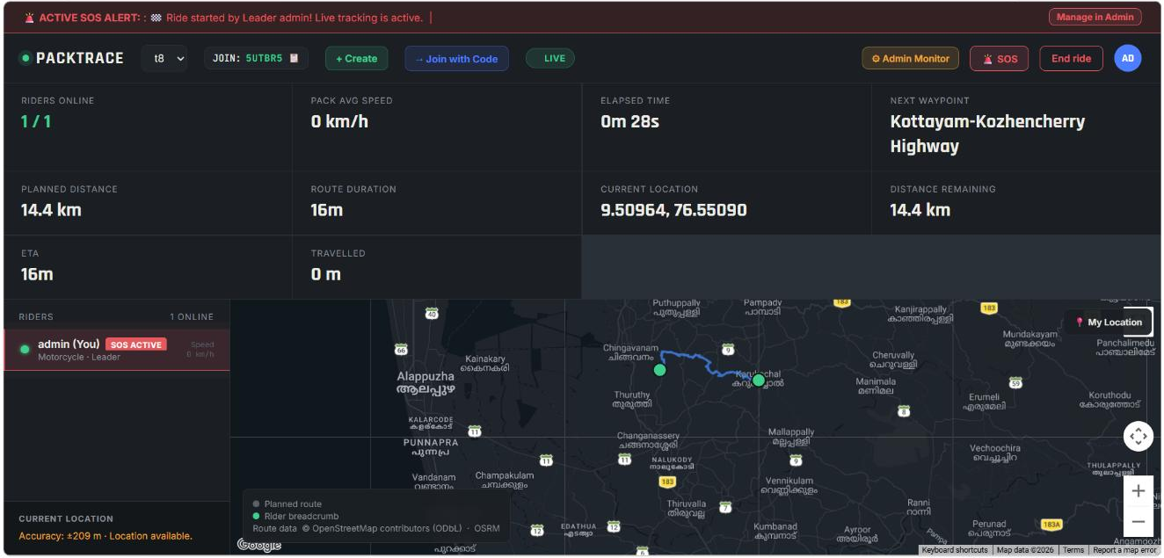
Live tracking dashboard
APPLICATION SCREENSHOTS
1
Ride controls
1
5
Ride selector, join code, Create, Join with Code, LIVE status
2
2
Ride statistics
Riders online, average speed, elapsed time, next waypoint, planned distance, ETA, distance remaining, travelled
3
3
Rider list
Current rider with role and status badge
4
4
Google Map
Planned route (blue), rider breadcrumb trail, markers
5
Actions
SOS, End ride, Admin Monitor
Implemented: live map, route, breadcrumb, ETA
Notes:
Screenshot is from report Figure 6.1 (development run, one rider, planned route 14.4 km). Planned distance, route duration, distance remaining, ETA and travelled distance are all computed fields in the dashboard (group_live_state_api / dashboard.html). Values in the screenshot are from one test run and are not system constants.

Slide 26
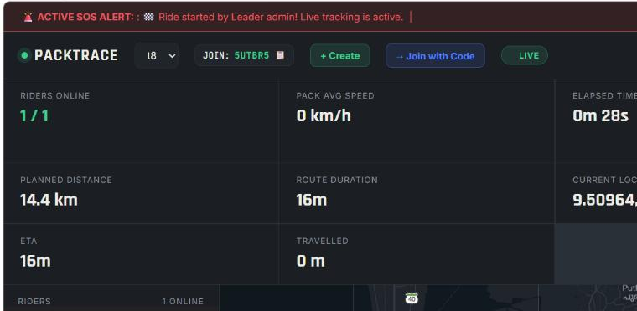
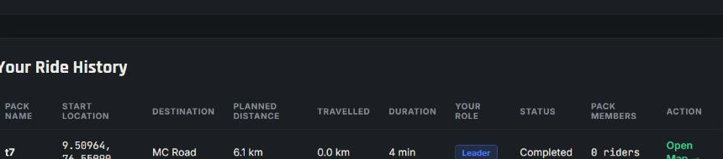
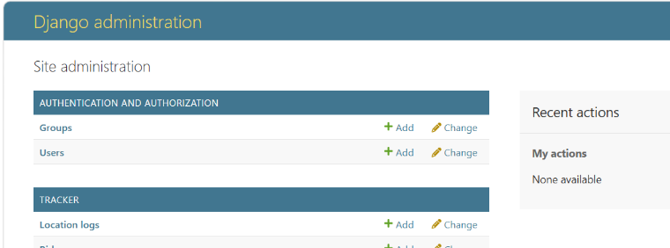
Safety, history and administration
APPLICATION SCREENSHOTS
SOS alert banner and rider badge
Ride history
Alert banner, SOS control, rider SOS ACTIVE badge
Pack, start, destination, distances, duration, role, status, members
Django administration
Users, rides, members, location logs, SOS alerts
Notes:
Real screenshots: SOS/alert banner and rider badge (report Figure 5.7 / 6.1), ride history (Figure 5.8), Django admin (Figure 5.9). IMPORTANT: the alert banner visible in the report screenshots reads "Ride started by Leader admin!" because start/end ride notices are stored as alert records; it is not a manually raised SOS. Disconnected-rider, last-known-location and route-deviation screenshots do not exist in the report, so those tiles are placeholders to fill with a fresh capture.

Slide 27
User acceptance testing
TESTING AND RESULTS
22 / 22
UAT cases recorded as passed
0
cases still pending
23
automated tests in tests.py
Test case | Expected result | Actual result | Status
Valid login (UAT02) | Session created; dashboard shown | Executed | Pass
Invalid login (UAT03) | Error message; no session | Executed | Pass
Create ride (UAT05) | Group created; creator is leader | Executed | Pass
Join ride (UAT06) | Rider added to the group | Executed | pass
GPS permission (UAT08) | Message when denied; sharing when allowed | Executed | Pass
Live location (UAT09) | New location sent and stored | Executed | Pass
Multiple riders (UAT07, UAT10) | All riders listed; a marker for each | Executed | pass
WebSocket update (UAT11) | Other rider's map updates without reload | Executed | Pass
Disconnect, last known (UAT12-13) | Marked disconnected; last location stays | Executed | pass
Route deviation (UAT15) | Deviation detected and reported | Executed | Pass
SOS alert (UAT16-17) | Alert raised, stored, received by riders | Executed | Pass
Ride history (UAT19) | Completed ride listed with details | Executed | Pass
Statuses as recorded in report Table 6.2. No performance figures were measured.
Notes:
Statuses are copied from report Table 6.2 (22 cases): 17 recorded as executed/pass; UAT06, UAT07, UAT10, UAT12 and UAT13 are recorded as Pending. The report text itself says results are still to be recorded, so update this slide before the viva if more cases have been run. tracker/tests.py also holds 23 automated tests (including disconnect detection and reconnect); they were not executed here. No performance measurements exist, so none are shown.

Slide 28
Existing approach vs PackTrace
COMPARISON
Feature | Existing approach | PackTrace | Evidence in code
Group management | Limited | Ride-based groups with join code, leader | RideGroup, RideMember
Common map | Limited / separate shares | Centralised Google Map for the ride | dashboard.html
Live rider tracking | Individual sharing | Group tracking over WebSocket | consumers.py
Disconnect handling | No dedicated mechanism | Last known location retained (45 s rule) | services.py
Route deviation | Not ride-specific | Detected beyond 500 m of route | check_route_deviation
SOS | General communication | Ride-level in-app alert to group and admin | handle_sos_alert
Ride history | Limited | Completed rides with distance, duration | ride_history_view
Admin monitoring | Not available | Django Admin and monitor page | admin.py, admin_monitor
SOS and alerts are in-app only: no SMS, email or push notifications.
Notes:
Each PackTrace claim was checked in the source. Group management: RideGroup.join_code + RideMember. Common map: dashboard.html Google Maps. Group tracking: consumers.py broadcast. Disconnect: services.py (45 s) + consumers.disconnect. Route deviation: services.check_route_deviation (500 m). SOS: consumers.handle_sos_alert (WebSocket only; in-app, no SMS/email/push). History: views.ride_history_view. Admin: Django admin + /admin-monitor/.

Slide 29

Advantages, limitations and future scope
EVALUATION
Advantages
Limitations
Future scope
Centralised group visibility
Real-time location sharing
Runs in a browser, no install
No tracking hardware
Safety-oriented features
Ride history
GPS accuracy depends on device and surroundings
Needs continuous internet
Web app: background tracking is limited
Google Maps API key and usage limits
Development setup: SQLite, in-memory channel layer
Native Android / iOS app
Offline tracking, SMS fallback
Geofencing, low-battery alerts
Push, SMS, email, audio alerts
Automatic accident detection
Voice navigation, ride analytics
Notes:
Advantages: report Section 7.1. Limitations: report Sections 7.2 and 9.2, plus development-configuration facts from settings.py (SQLite, InMemoryChannelLayer, DEBUG=True). Future scope: report Section 9.3 (labelled as not present features).

Slide 30
Conclusion and outcome mapping
CONCLUSION
PackTrace gives group riders a centralised, browser-based place to share live locations, monitor group movement and receive safety alerts.
PROGRAMME OUTCOMES
PROGRAMME SPECIFIC OUTCOMES
PO1 Foundation
PO2 Problem analysis
PSO 1
Modern technologies: Django, WebSocket, geolocation, web mapping
PO3 Solution design
PO4 Modern tools
SDGS
9
Industry, Innovation and Infrastructure
PO5 Individual work
PO6 Project planning
real-time web and mapping
PSO 2
Computing principles: distance computation, real-time data, database design
PO8 Lifelong learning
11
Sustainable Cities and Communities
safer, coordinated group travel
Notes:
PO / PSO / SDG mapping from the report (PO1-PO8, PSO1-PSO2; SDG 3, 9 and 11). The report notes that the SDG 3 contribution is indirect: PackTrace supports safer riding but does not itself prevent accidents.

Slide 31
References
REFERENCES (1 OF 2)
[1] E. A. Aldhahri, A. A. Almazroi, M. H. Alkinani, M. Alqarni, E. A. Alghamdi, and N. Ayub, "GNN-RMNet: Leveraging graph neural networks and GPS analytics for driver behavior and route optimization in logistics," PLOS ONE, vol. 20, no. 8, Art. no. e0328899, Aug. 2025, doi: 10.1371/journal.pone.0328899.
[2] I. Moumen, N. Rafalia, J. Abouchabaka, and M. Aoufi, "Real-time GPS tracking system for IoT-enabled connected vehicles," E3S Web Conf., vol. 412, Art. no. 01095, 2023, doi: 10.1051/e3sconf/202341201095.
[3] P. Boronat, M. Pérez-Francisco, C. T. Calafate, and J.-C. Cano, "Towards a sustainable city for cyclists: Promoting safety through a mobile sensing application," Sensors, vol. 21, no. 6, Art. no. 2116, Mar. 2021, doi: 10.3390/s21062116.
[4] V. Pimentel and B. G. Nickerson, "Communicating and displaying real-time data with WebSocket," IEEE Internet Comput., vol. 16, no. 4, pp. 45–53, Jul./Aug. 2012, doi: 10.1109/MIC.2012.64.
[5] P. A. Zandbergen and S. J. Barbeau, "Positional accuracy of assisted GPS data from high-sensitivity GPS-enabled mobile phones," J. Navigation, vol. 64, no. 3, pp. 381–399, Jul. 2011, doi: 10.1017/S0373463311000051.
[6] J. White, C. Thompson, H. Turner, B. Dougherty, and D. C. Schmidt, "WreckWatch: Automatic traffic accident detection and notification with smartphones," Mobile Netw. Appl., vol. 16, no. 3, pp. 285–303, Jun. 2011, doi: 10.1007/s11036-011-0304-8.
[7] P. A. Zandbergen, "Accuracy of iPhone locations: A comparison of assisted GPS, WiFi and cellular positioning," Trans. GIS, vol. 13, no. s1, pp. 5–25, 2009, doi: 10.1111/j.1467-9671.2009.01152.x.
[8] S. Consolvo, I. E. Smith, T. Matthews, A. LaMarca, J. Tabert, and P. Powledge, "Location disclosure to social relations: Why, when, & what people want to share," in Proc. SIGCHI Conf. Human Factors in Computing Systems (CHI '05), Portland, OR, USA, 2005, pp. 81–90, doi: 10.1145/1054972.1054985.
Notes:
IEEE-format references [1]-[8], copied from the final report Chapter 11.

Slide 32
References (continued)
REFERENCES (2 OF 2)
[9] A. R. Beresford and F. Stajano, "Location privacy in pervasive computing," IEEE Pervasive Comput., vol. 2, no. 1, pp. 46–55, Jan.–Mar. 2003, doi: 10.1109/MPRV.2003.1186725.
[10] R. W. Sinnott, "Virtues of the Haversine," Sky & Telescope, vol. 68, no. 2, p. 159, Aug. 1984.
[11] A. Popescu, Ed., "Geolocation API," W3C Recommendation, Sep. 1, 2022. [Online]. Available: https://www.w3.org/TR/2022/REC-geolocation-20220901/
[12] Google, "Google Maps Platform documentation: Maps JavaScript API." [Online]. Available: https://developers.google.com/maps/documentation/javascript
[13] Python Software Foundation, "Python documentation." [Online]. Available: https://docs.python.org/
[14] Django Software Foundation, "Django documentation." [Online]. Available: https://docs.djangoproject.com/
[15] Django Software Foundation, "Channels documentation." [Online]. Available: https://channels.readthedocs.io/
[16] I. Fette and A. Melnikov, "The WebSocket Protocol," IETF, RFC 6455, Dec. 2011. [Online]. Available: https://www.rfc-editor.org/info/rfc6455
[17] OWASP Foundation, "OWASP Top Ten." [Online]. Available: https://owasp.org/www-project-top-ten/
Notes:
IEEE-format references [9]-[17], copied from the final report Chapter 11.

Slide 33
THANK YOU
Questions & Discussion
PackTrace
GPS-Based Group Ride Tracking System
Alan Johny | MLM25MCA2015
Notes:
Closing slide. Invite questions; the demo video is on slide 27.

